Slide 1

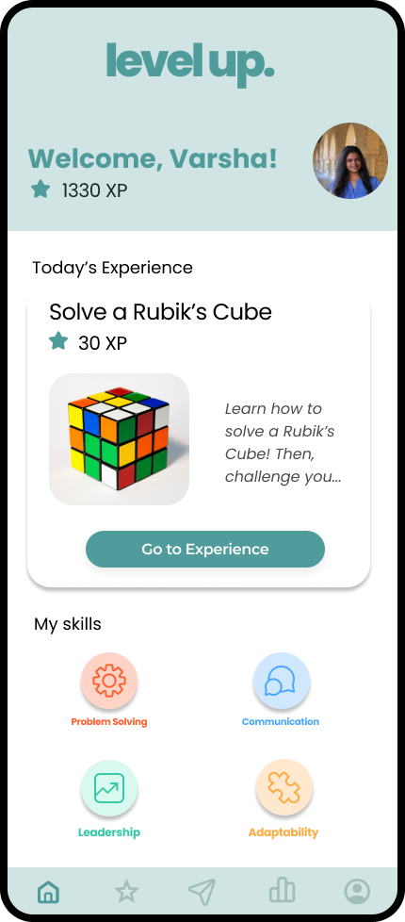
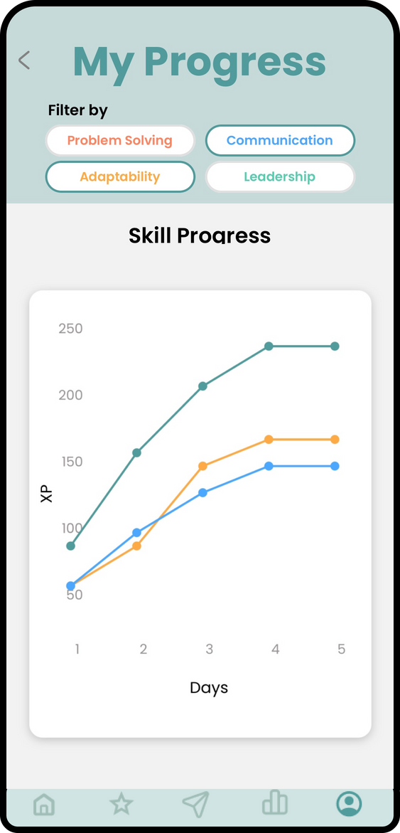
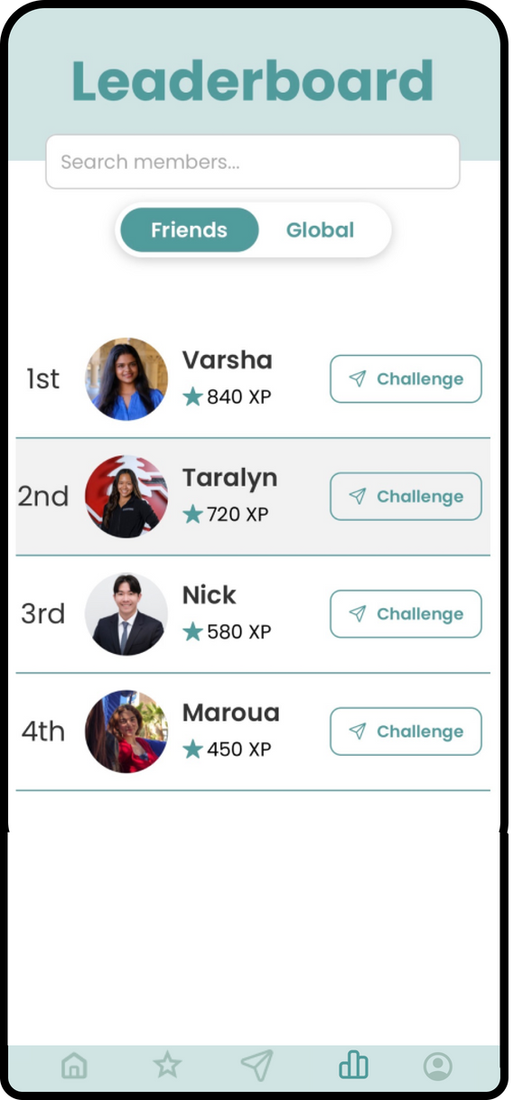
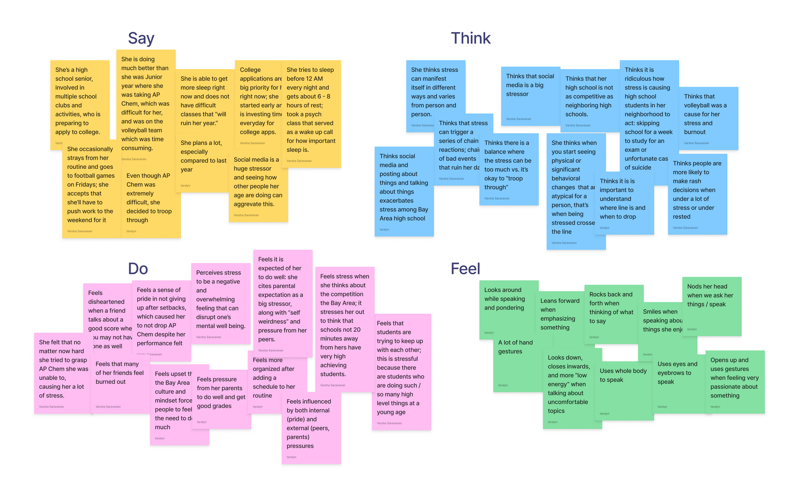
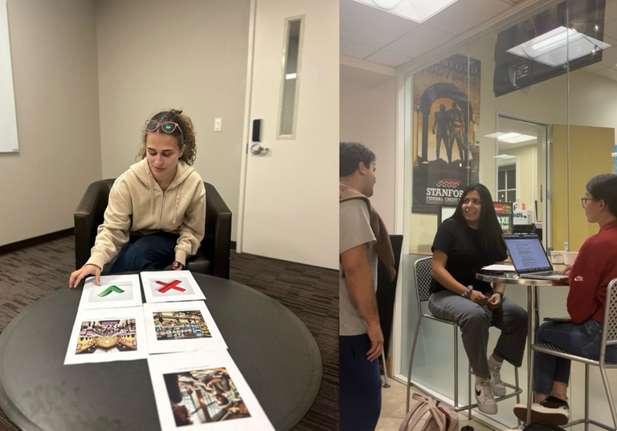
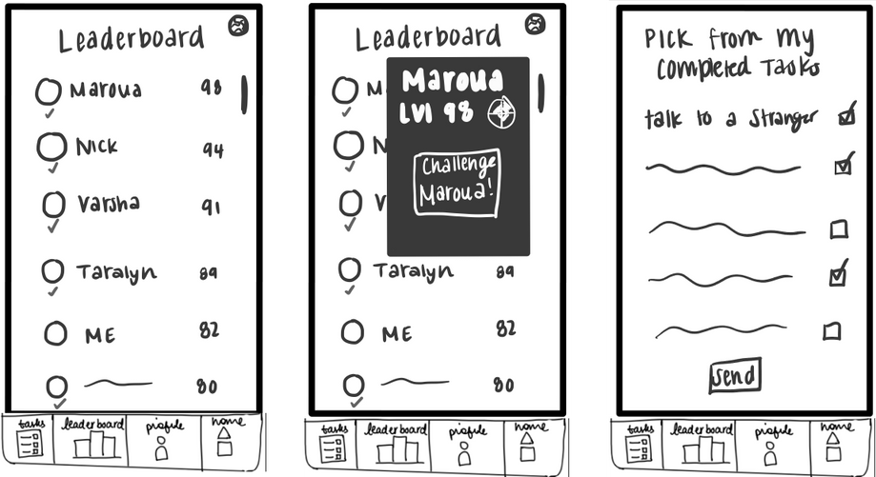
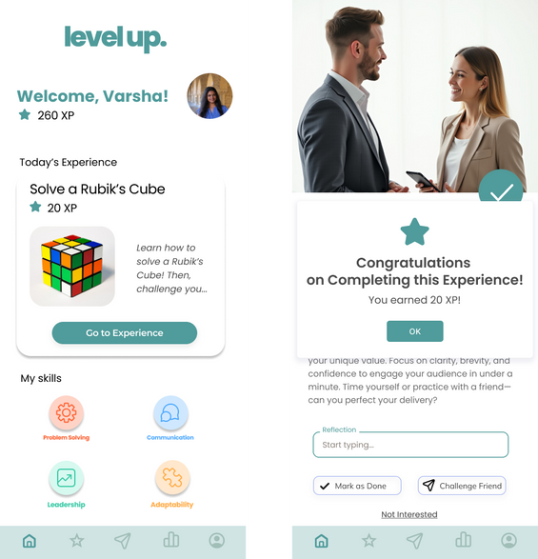
Build essential skills, one experience at a time
The Problem
Students and early career professionals struggle to develop vital interpersonal skills, often causing stress in career growth and navigation.
Our Solution
We break down the challenge of building interpersonal skills into bite-sized experiences across four key areas.
Design Process
Access Diverse Experiences
Track Progress Over Time
Compete with Friends
Needfinding
Experience Prototype
Lo-fi Prototype
Med-fi Prototype
Maroua B, Nick P, Taralyn N, Varsha S.
CS147 Autumn 2024
https://hci.stanford.edu/courses/cs147/2024/au/projects/Design-for-Healthy-Behaviors/LevelUp

